Slide 1

Institute : Birla Vishvakarma Mahavidyalaya
(BVM) Engineering College
Department : Computer Engineering Department
Course : CP442 PROJECT – II
Project Title : Accident Detection & Response System
ID NO : 17CP021: Bhatt Shlok Prashant​ 17CP032: Panchal Jainil Rakeshchandra
GUIDED BY :
Prof. Mahasweta J. Joshi
Prof. Dipa Soni

Slide 2
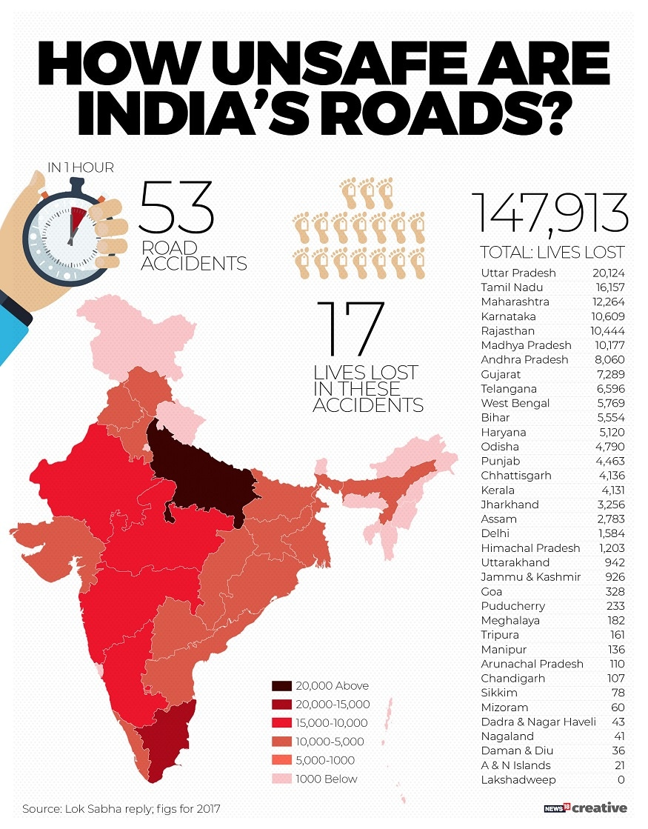
Aim Of Project
To develop an A.I. based Accident Detection &
Alert System
It will help reducing the response time of rescue
agencies
Victims of accident gets medical attention in
timely manner
[1]

Slide 3
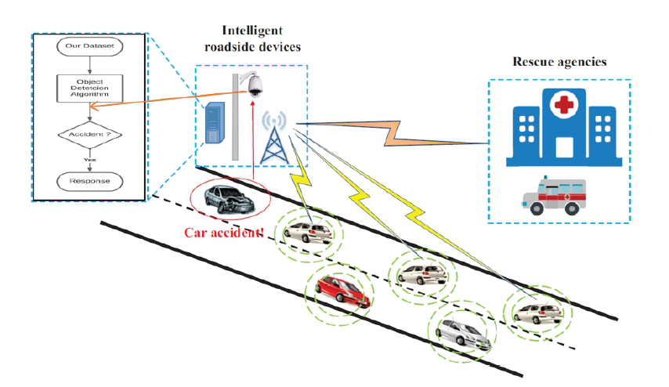
Proposed System
[2]

Slide 4
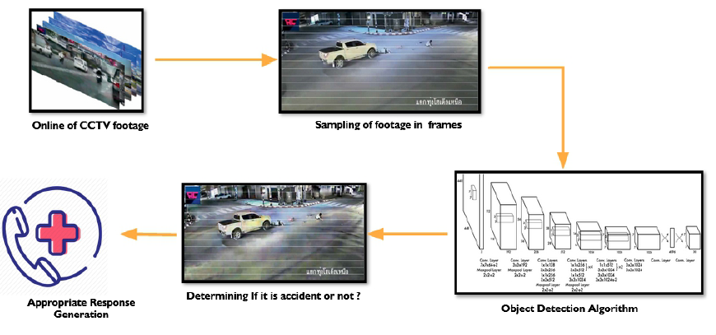
System-flow Architecture

Slide 5
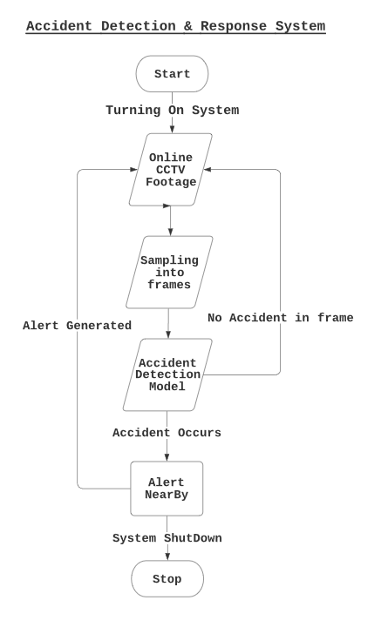
Flow Chart

Slide 6
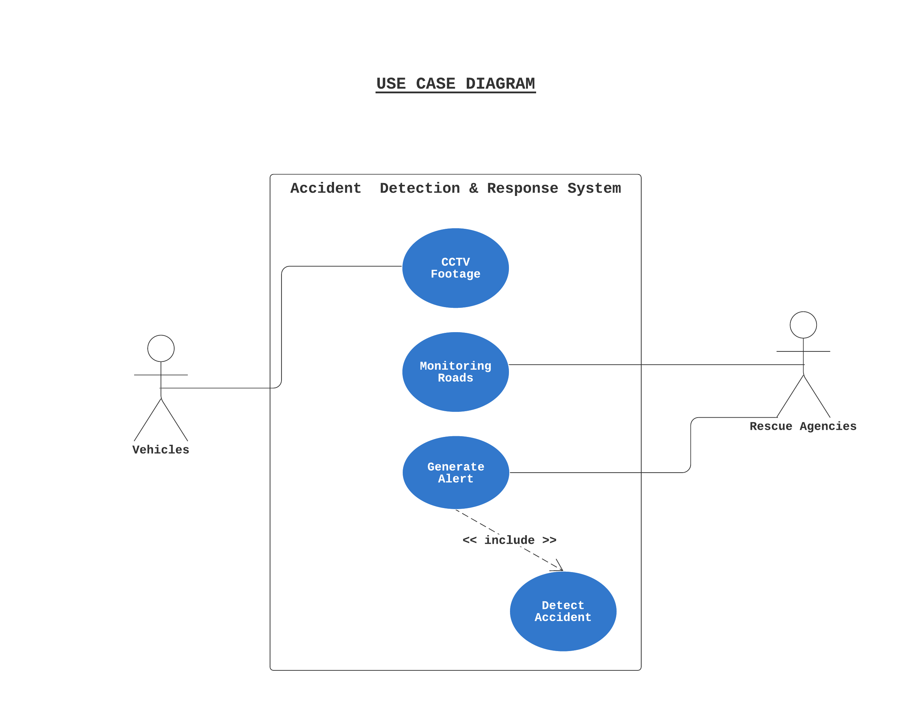
Use case Diagram

Slide 7
Project Workflow
STEP:1
Collecting – Processing Dataset
STEP:2
Training the model
STEP:3
Model Comparison & Testing
STEP:4
Deploying the model
STEP:5
Triggering Event
(YOLOv3 ,SSD MobileNet & Faster RCNN)
(Accident Footage Dataset )
(API & WEB UI)
(Response Generation)

Slide 8
Dataset
[1] Shah, Ankit and Lamare, Jean Baptiste and Anh, Tuan Nguyen and Hauptmann, Alexander CADP: “A Novel Dataset for CCTV traffic Camera based Accident Analysis ” https://arxiv.org/pdf/1809.05782v2.pdf
[2] IITH_Accident Dataset Request (300 MB) Hyderabad City Video Dataset for Accident Detection from Hyderabad City CCTV Network https://www.iith.ac.in/vigil/resources.html
[3]Anticipating Accidents in Dashcam
https://visionlab.uncc.edu/download/summary/60-data/477-ucf-anomaly-detection-dataset

Slide 9
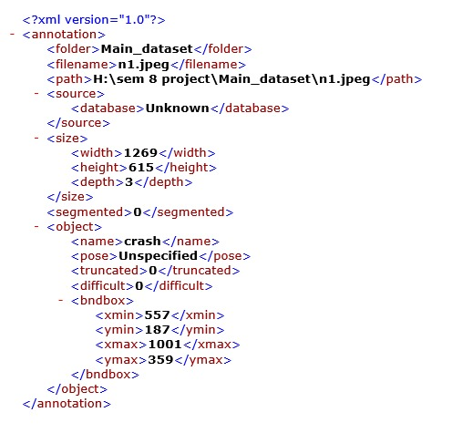
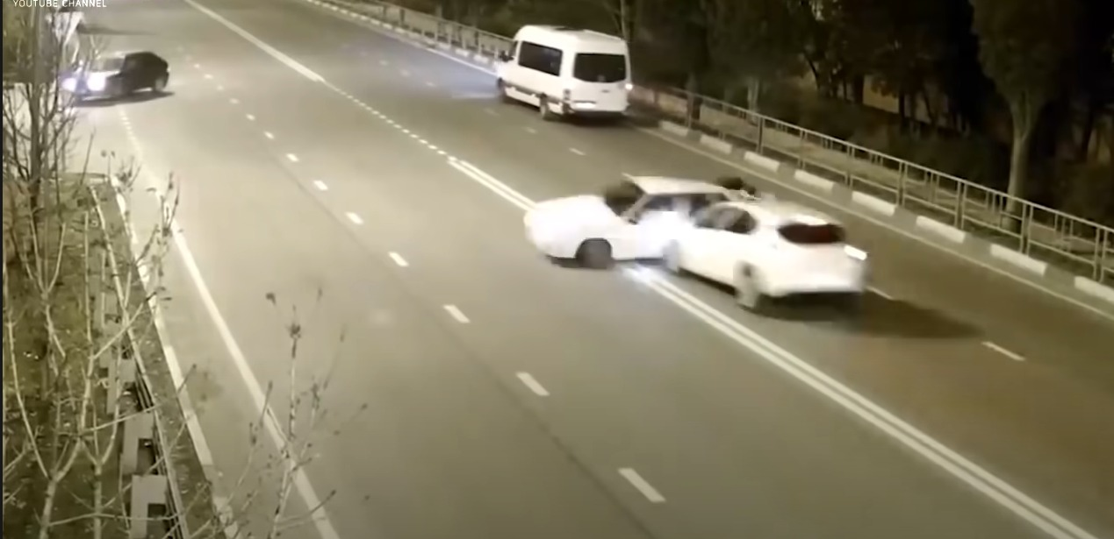
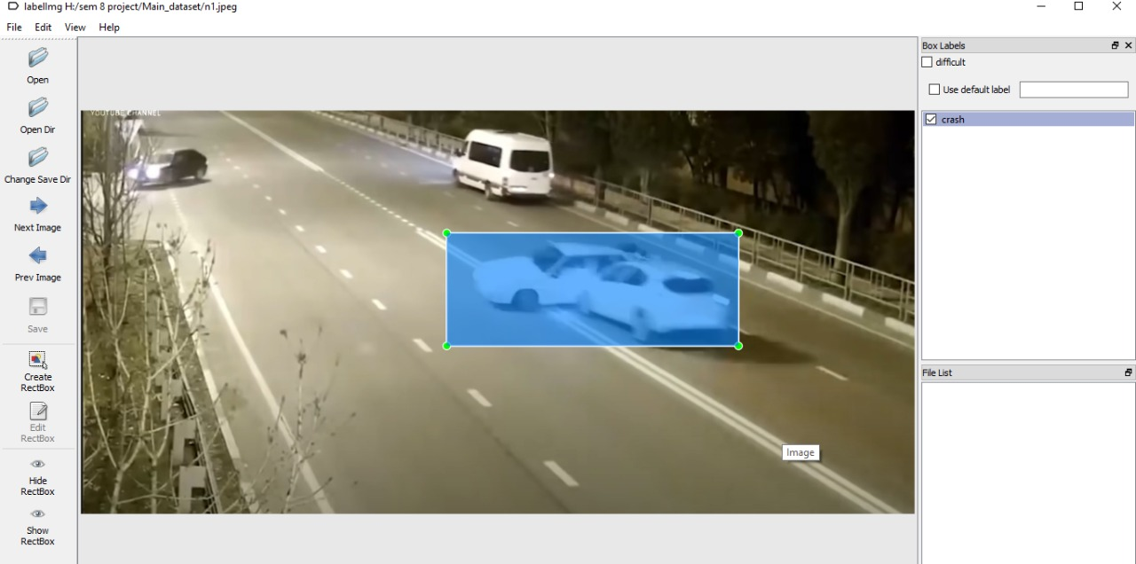
Pre - processing
Handpicking the accident frame from Video files
Annotating with IBM Cloud Annotation Tool , LabellMg
Getting Compatible Format of Dataset
Original Image
Labelled Image
Annotation File

Slide 10
Models
1. YOLO V3
2. SSD MobileNet
3. Faster RCNN
Object Detection includes both object classification & object localization

Slide 11
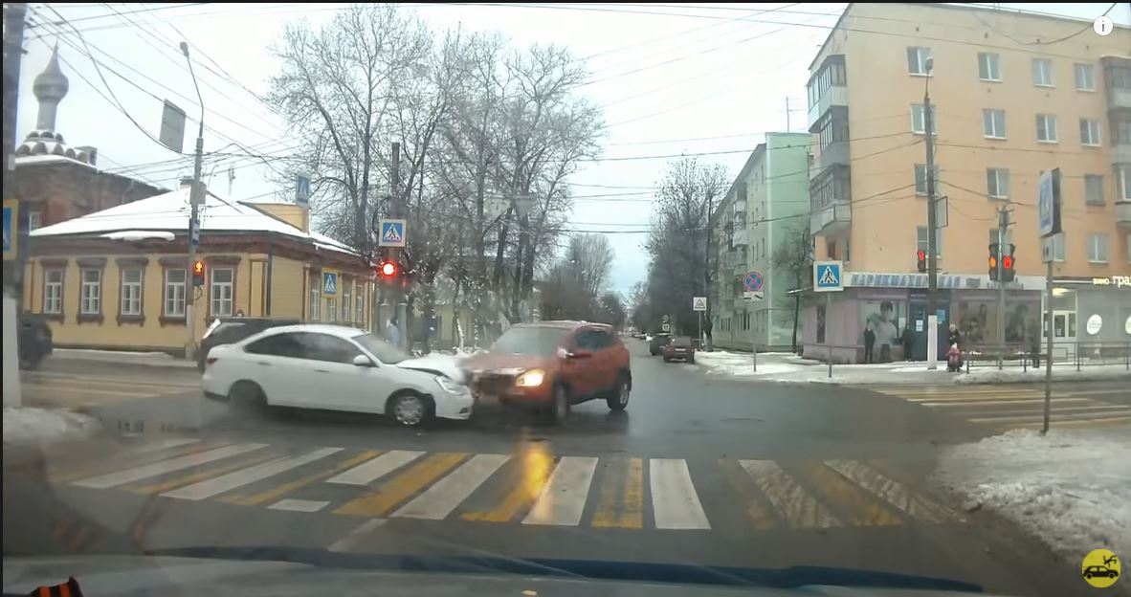
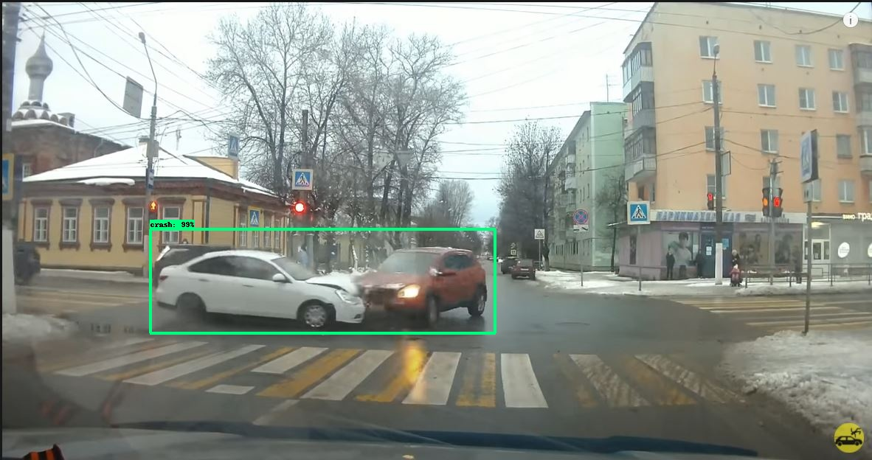
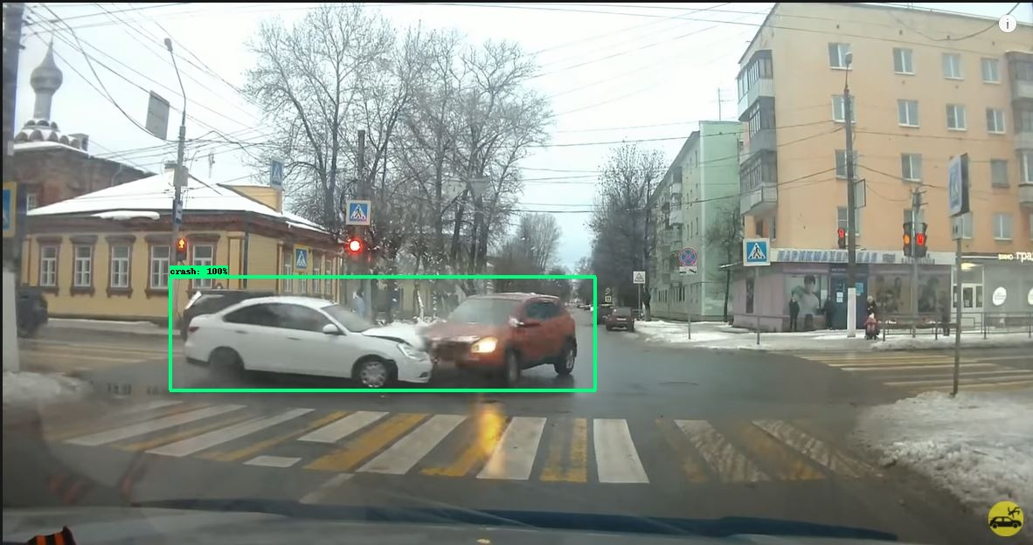
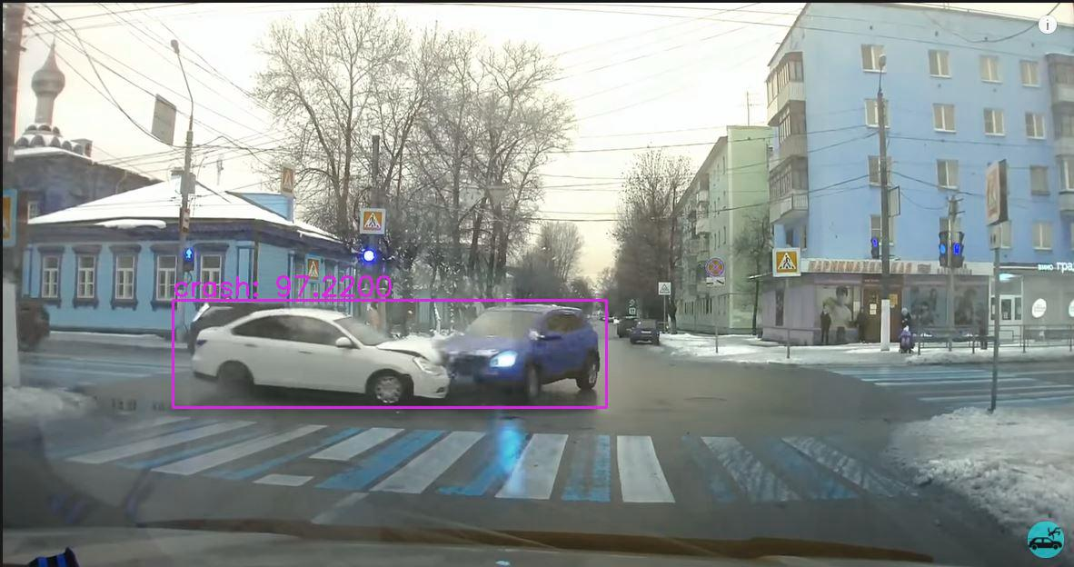
Trained Models’ Outputs ( Confidence Threshold = 0.5)
Ground Truth Predicted | accident | no_accident
accident | TP | FN
no_accident | FP | TN
Ground Truth Description | SSD MobileNet Output | Faster RCNN Output | YOLO V3 Output
Accident in frame (day time) | Detected accident with a very high confidence score(TP) | Detected accident with a very high confidence score(TP) | Detected accident with a very high confidence score(TP)

Slide 12
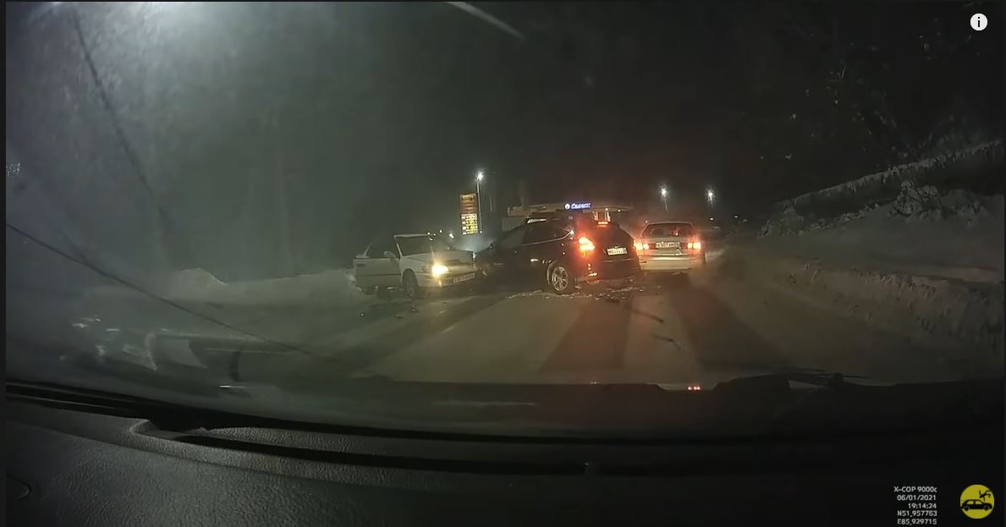
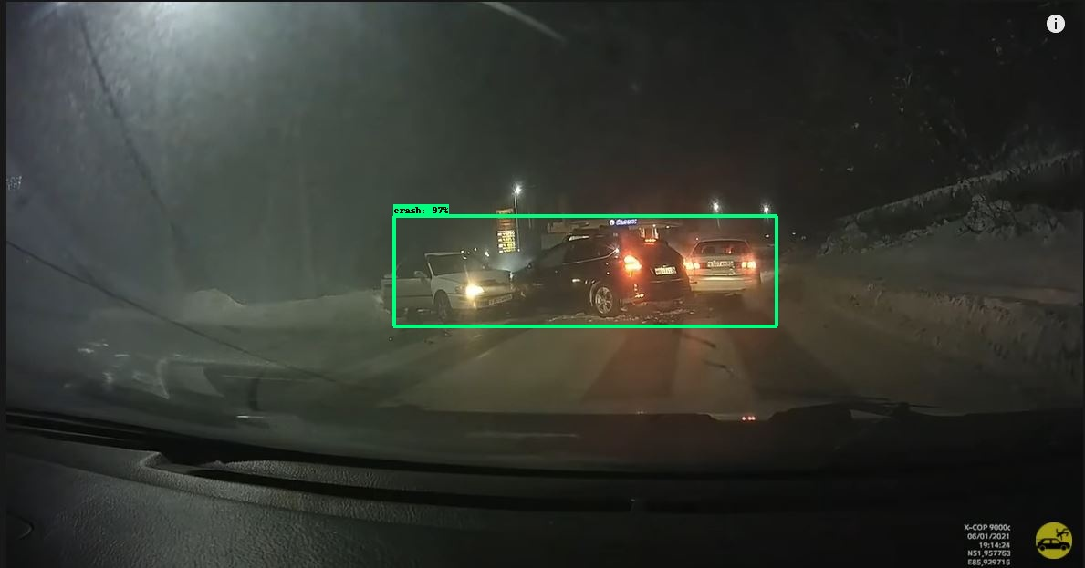

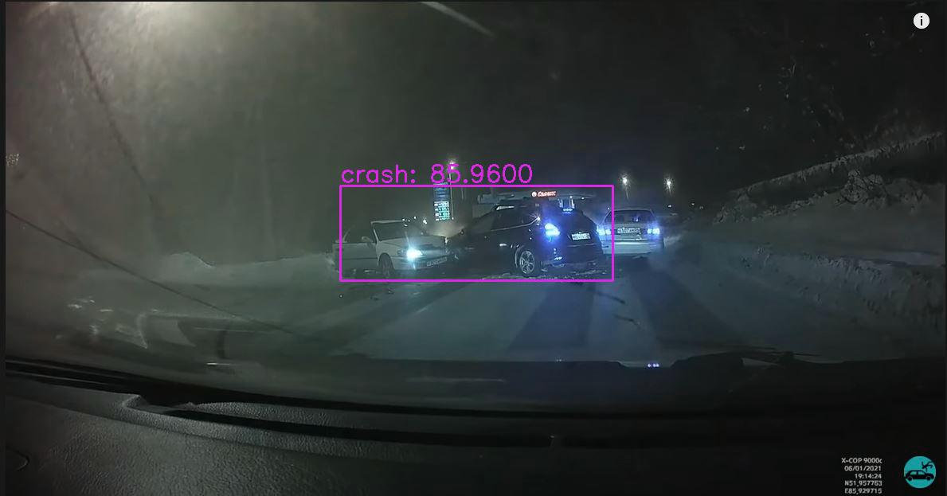
Trained Models’ Outputs
Ground Truth Description | SSD MobileNet Output | Faster RCNN Output | YOLO V3 Output
Accident in frame (night time) | Detected accident with a very high confidence score (TP) | Detected accident with a very high confidence score (TP) | Detected accident with a high confidence score (TP)

Slide 13
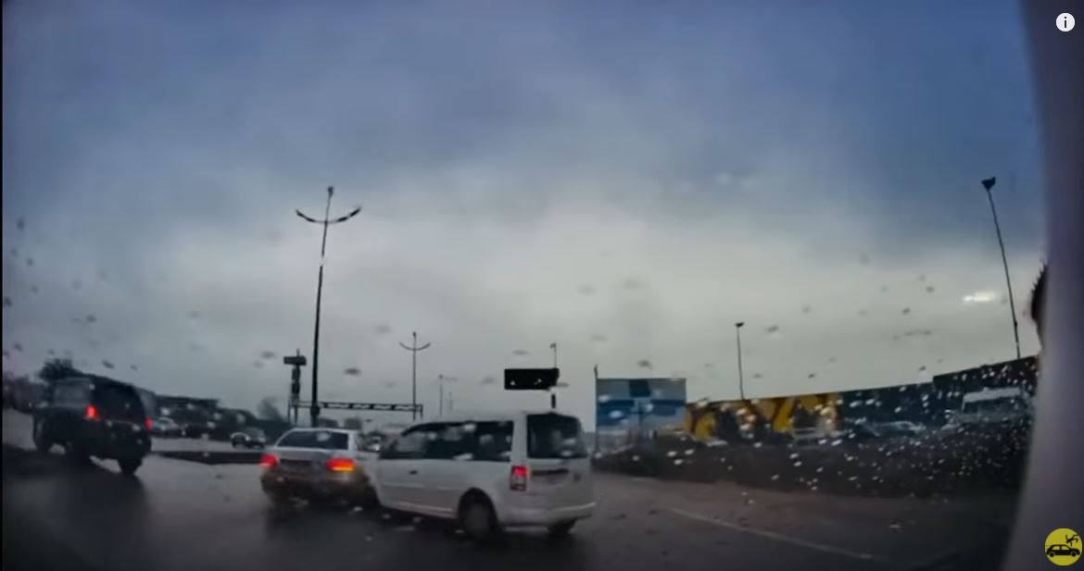
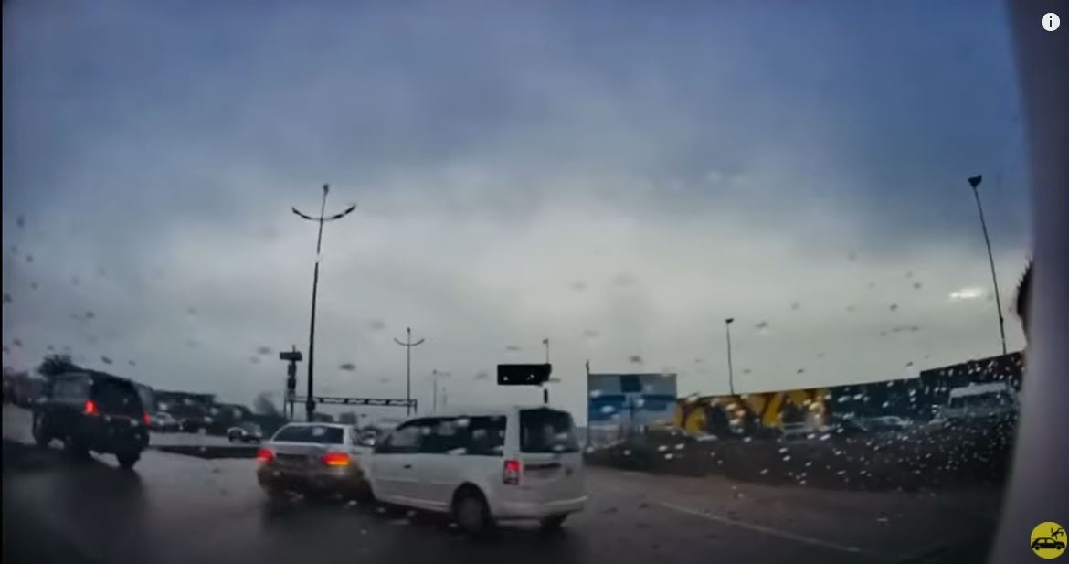
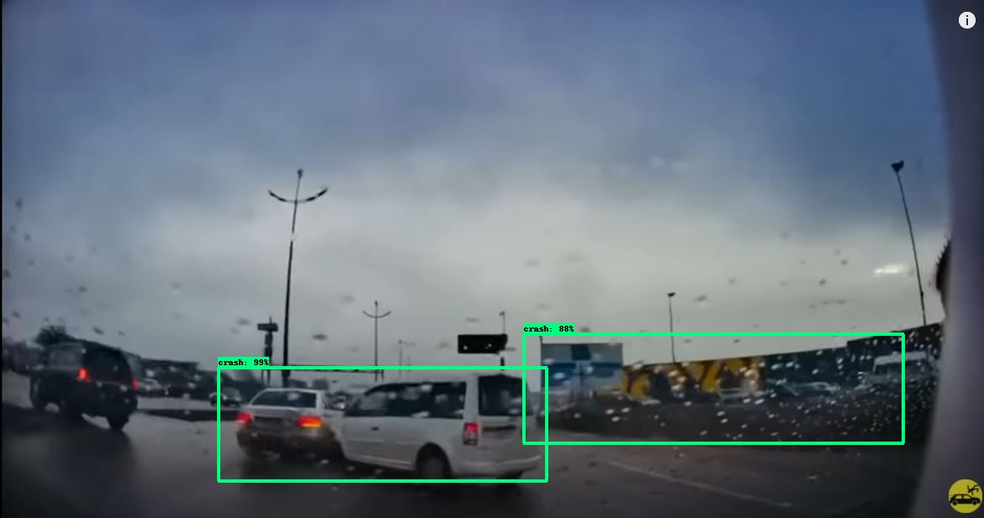
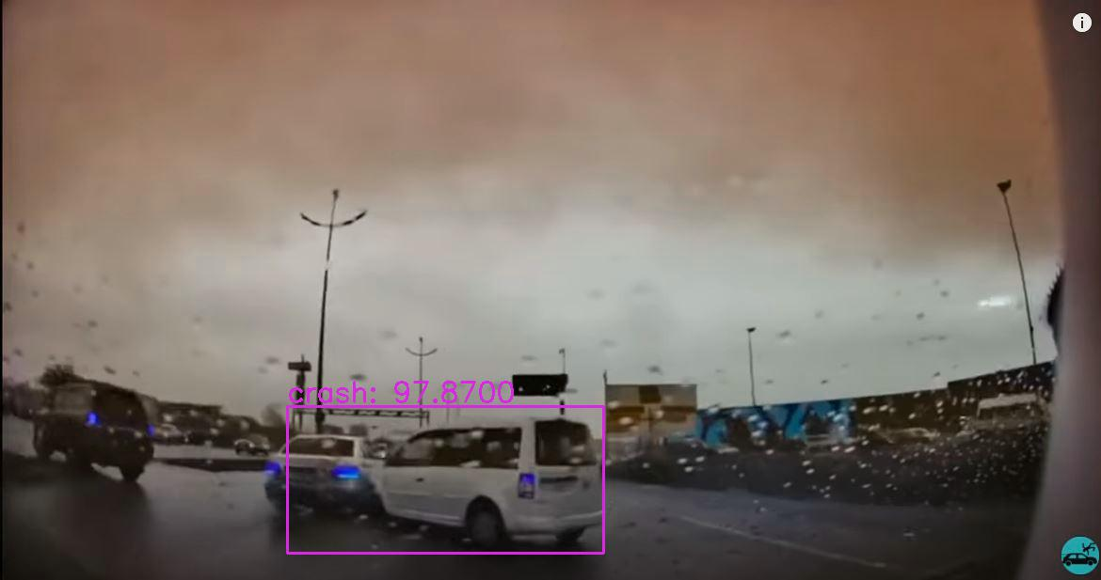
Trained Models’ Outputs
Ground Truth Description | SSD MobileNet Output | Faster RCNN Output | YOLO V3 Output
Accident in frame (cloudy sky) | Did not detect any accident (FN) | Detected two accidents in the image where one was TP but there is FP with high confidence score | Detected accident with a very high confidence score (TP)

Slide 14
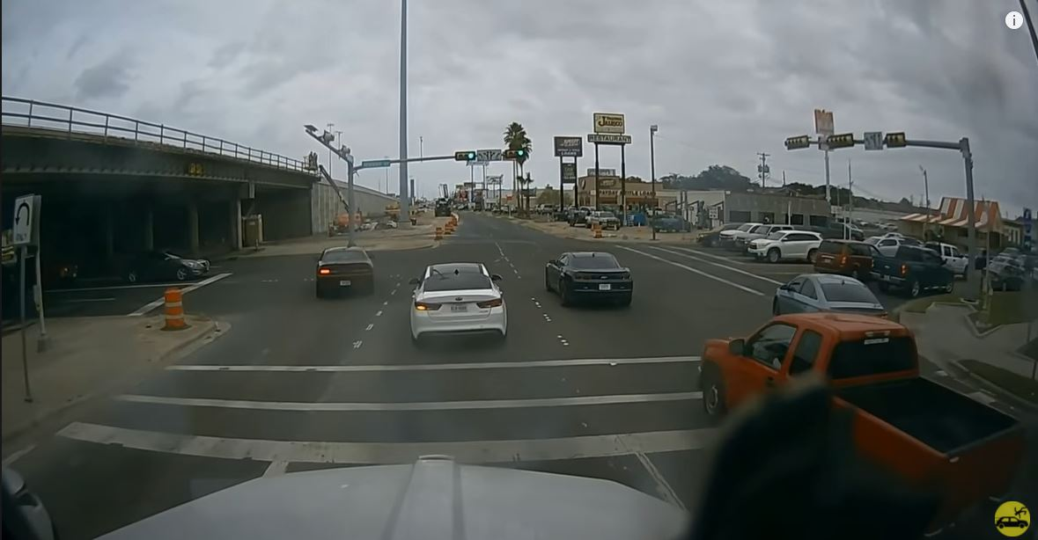

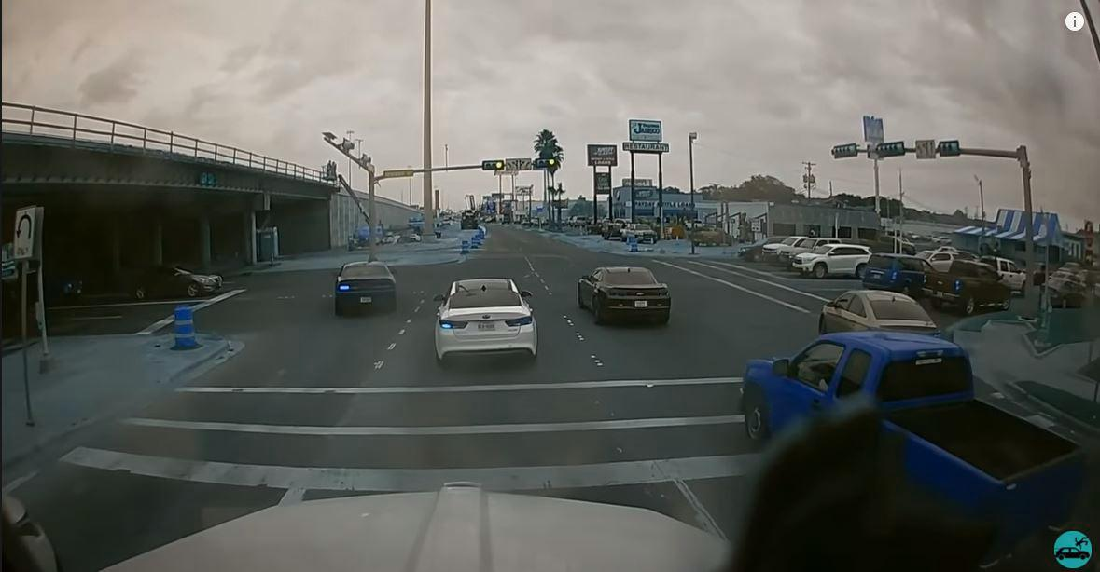
Trained Models’ Outputs
Ground Truth Description | SSD MobileNet Output | Faster RCNN Output | YOLO V3 Output
No Accident in frame (traffic) | Did not detect an accident (TN) | Did not detect an accident (TN) | Did not an detect accident (TN)

Slide 15
COMPARISON
False-positive rate: YOLO v3 < SSD mobilenet < Faster RCNN
FPS on GTX 1050 : YOLO v3 > SSD mobilenet > Faster RCNN
Thus we decided YOLO v3 model for our proposed system based on the analysis which is shown in graph.

Slide 16

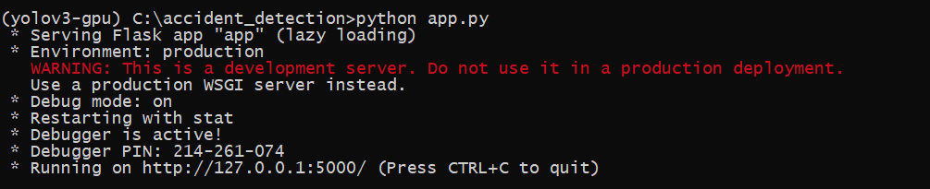
Deploying the model (API & WEB UI)
Created Object Detection API ( Accident detection ) using Flask.

Slide 17
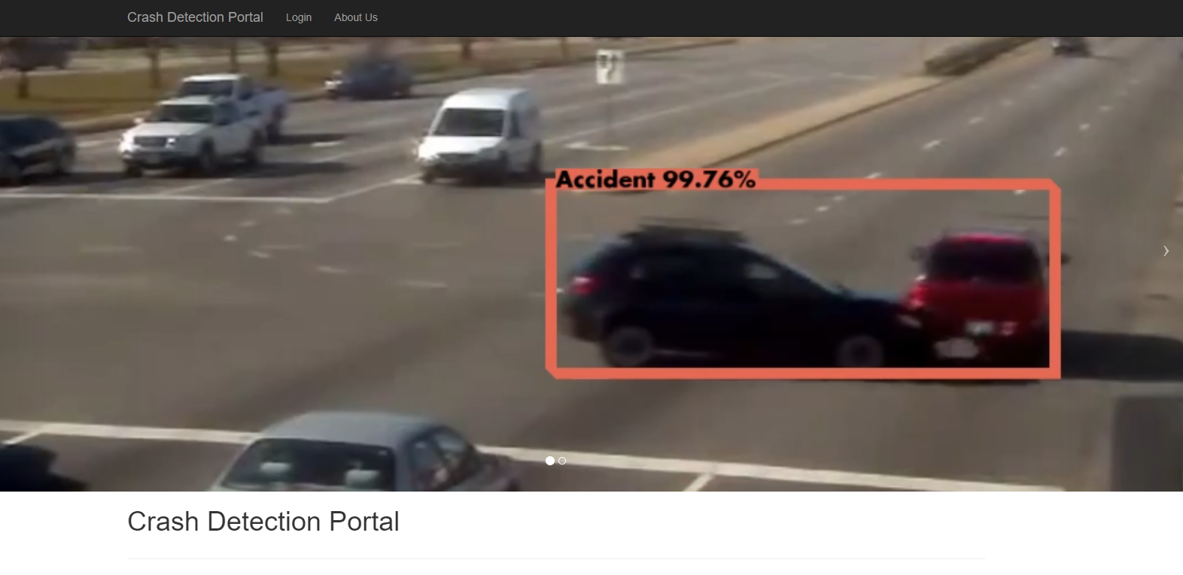
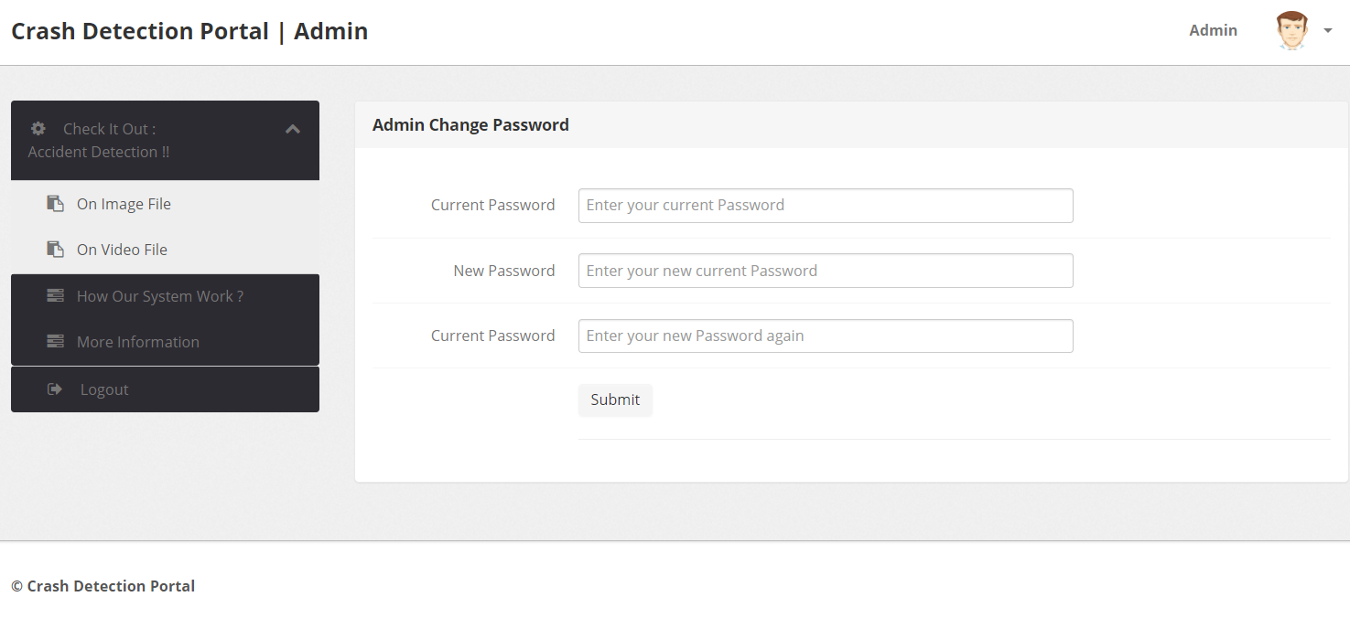
Deploying the model (API & WEB UI)
Portal Homepage
Admin Dashboard

Slide 18
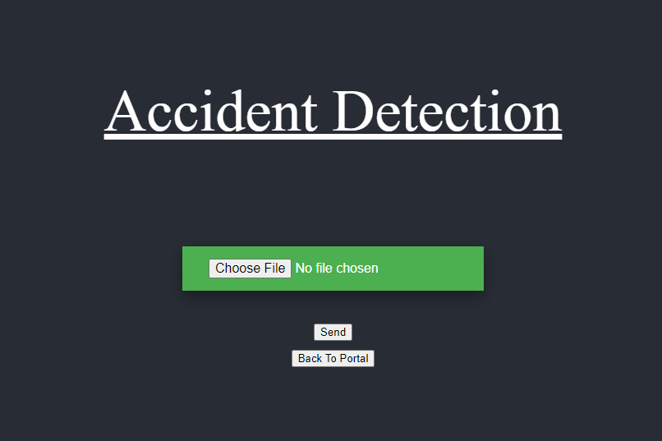
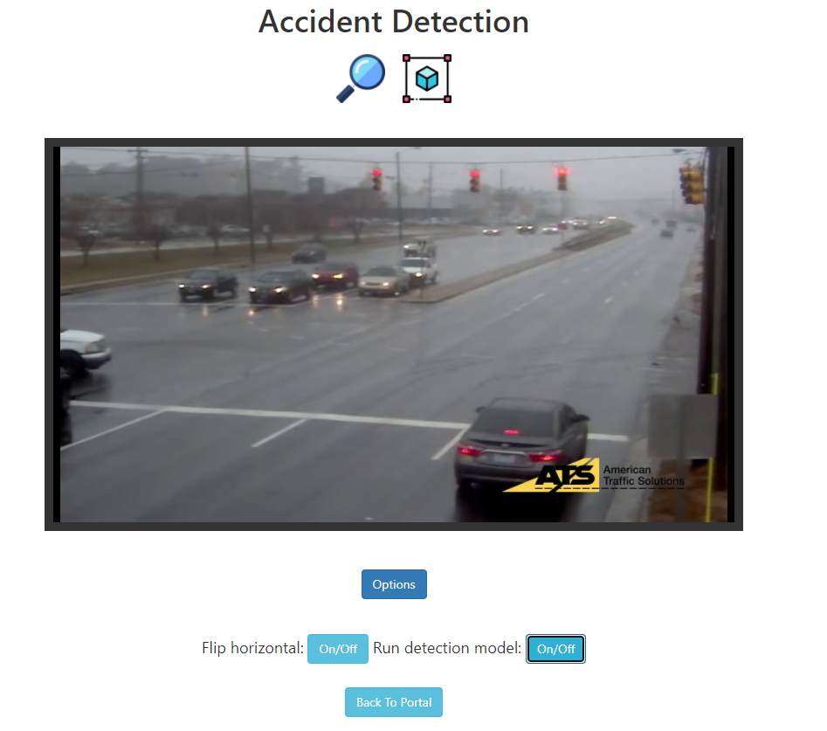
Deploying the model (API & WEB UI)
Accident Detection on uploaded image file
Accident Detection on Video

Slide 19
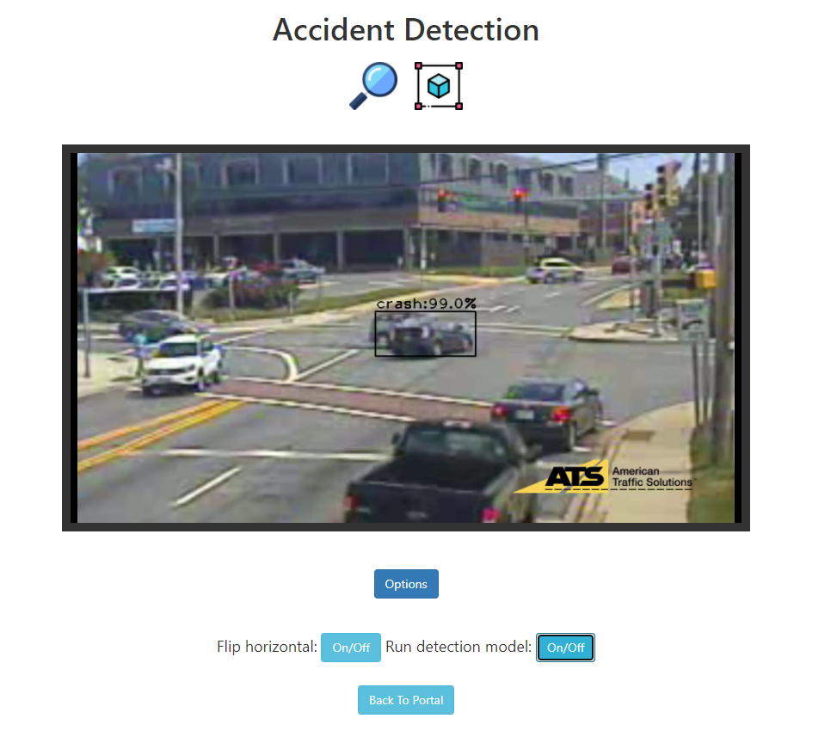
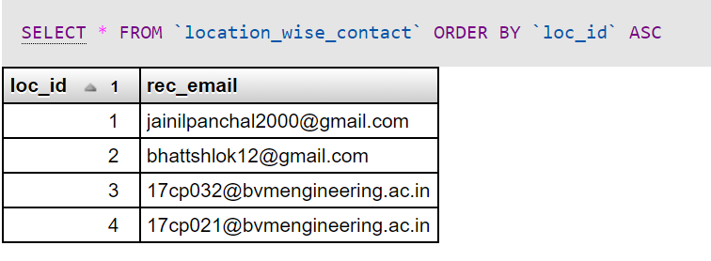
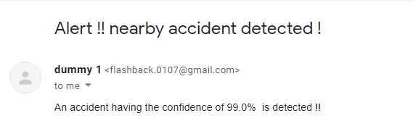
Response System
Database
Sample Email Response Format
Accident Detection on Video

Slide 20
Portal Walkthrough
Login into Crash Detection Portal
Select “Check it out ” option from sidebar
In the Check it out section there are two tabs namely, "On Image file" and "On Video file" where we can check the accident detection on image and video respectively
In the On Image file section, there is an "Upload Image" button for uploading images and "Send" button to conduct the accident detection
In the On Video file section, the video is streaming and there is an "ON/OFF" button to conduct the accident detection
One tab regarding “How our system works?” to know more about our project
Live Demonstration

Slide 21
Challenges faced
Footage of Accident has limited Access. It is governed by Traffic authorities or the
Government and therefore not publicly available due to sensitive nature of recording such type of data
Scarcity of dataset containing accident footage on Indian roads
Training of model with dataset of limited variety & quantity
Low resolution of CCTV footage
Getting low FPS while running object detection on local machine ( GPU : NVIDIA GTX1050 )
Integrating & coordinating all systems of rescue agencies

Slide 22
Future Work
Including other important details in e-mail generated response along with confidence score
Minimizing false predictions while detecting accidents
Improving accuracy of the model during evenings & nights & detecting accidents in traffic
Developing more efficient and effective response system

Slide 23
References
[1] Source: news18.com
Available at: https://bit.ly/2NsHljc
[2] D. Tian, C. Zhang, X. Duan and X. Wang, "An Automatic Car Accident Detection Method Based on Cooperative Vehicle Infrastructure Systems," in IEEE Access, vol. 7, pp. 127453-127463, 2019, doi: 10.1109/ACCESS.2019.2939532
Available at: https://ieeexplore.ieee.org/abstract/document/8832160
[3] :Chen Wang,Yulu Dai,Wei Zhou and Yifei Geng”A Vision-Based Video Crash Detection Framework for Mixed Traffic Flow Environment Considering Low-Visibility Condition”, Journal of Advanced Transportation, vol. 2020, Article ID 9194028, Jan., 2020.
Available at: https://www.hindawi.com/journals/jat/2020/9194028/
[4] Huang, Y.-Q.; Zheng, J.-C.; Sun, S.-D.; Yang, C.-F.; Liu, J. Optimized YOLOv3 Algorithm and Its Application in Traffic Flow Detections. Appl. Sci. 2020, 10, 3079.
Available at: https://www.mdpi.com/2076-3417/10/9/3079
[5] The AI Guy. (YouTube) YOLOv3-Cloud-Tutorial,
Available at (Video): https://www.youtube.com/watch?v=10joRJt39Ns
Available at: https://github.com/theAIGuysCode/YOLOv3-Cloud-Tutorial

Slide 24
References
[6] Joseph Redmon and Santosh Kumar Divvala and Ross B. Girshick and Ali Farhadi (2015). You Only Look Once: Unified, Real-Time Object DetectionCoRR, abs/1506.02640.
Available at: https://arxiv.org/abs/1506.02640
[7] Pranali Satalgaonkar "Car-Accident-Detection-Using-Faster-RCNN",
Available at: https://github.com/PranaliSatalgaonkar/Car-Accident-Detection-Using-Faster-RCNN
[8] TensorFlow 2 Detection Model Zoo
Available at : https://github.com/tensorflow/models/blob/master/research/object_detection/g3doc/tf2_detection_zoo.md
[9] Training-a-Custom-TensorFlow-2.X-Object-Detector by Armaan Priyadarshan
Available at : https://github.com/armaanpriyadarshan/Training-a-Custom-TensorFlow-2.X-Object-Detector
[10] Object Detection API using YOLO and FLASK by Asmit Vimal
Available at : https://github.com/ViAsmit/Object-Detection-YOLO
[11] Diegoinacio, object-detection-flask-OpenCV,
Available at: https://github.com/diegoinacio/object-detection-flask-opencv

Slide 25

Thank You !!

